Slide 1

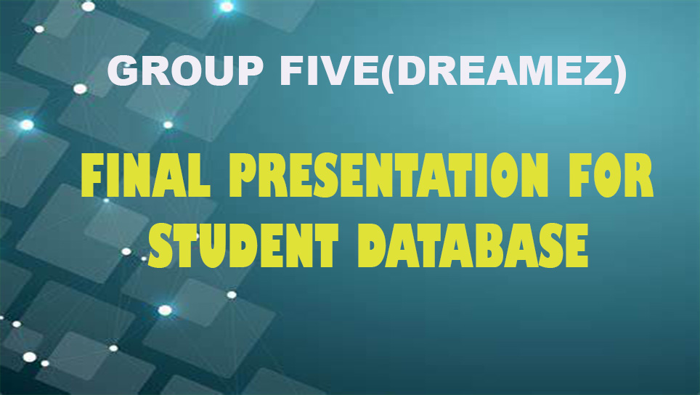

NANJING UNIVERSITY OF POSTS & TELECOMMUNICATIONS
INTERNATIONAL SOCCER TEAM

Slide 2

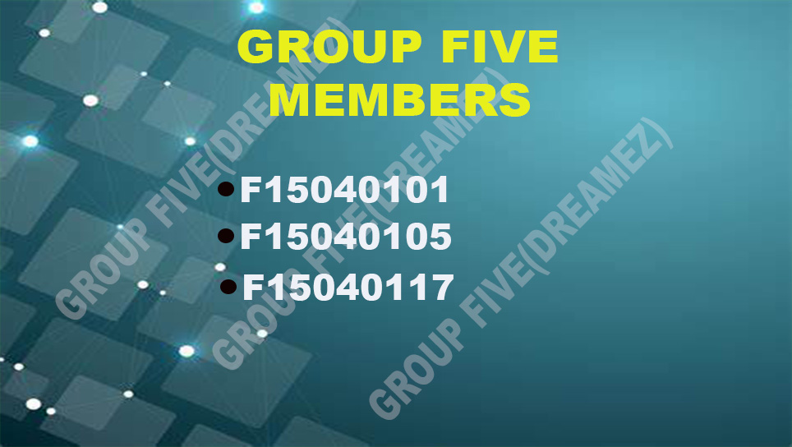
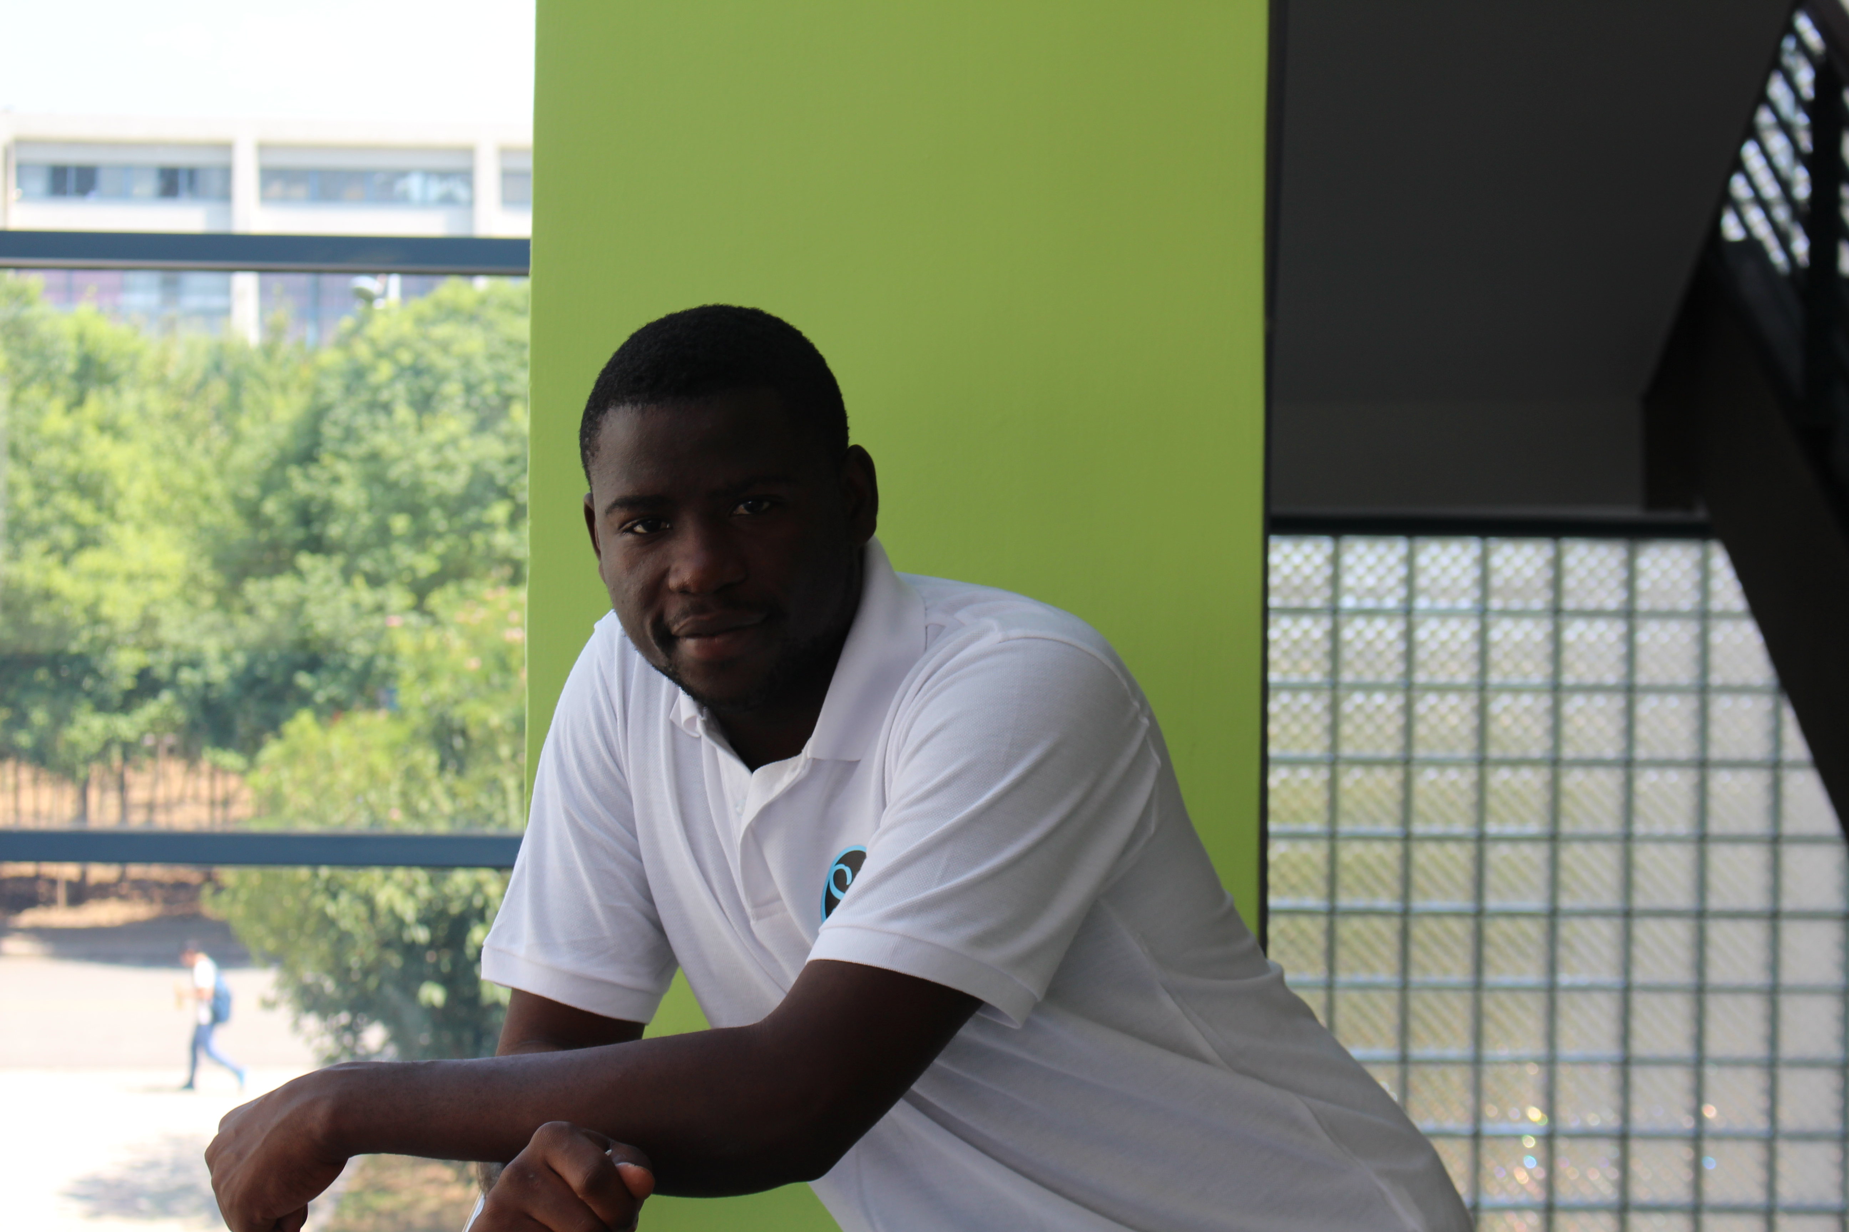
Coach of the soccer Team
NAME: SAMMY BLESS aka MR SAMMY
COUNTRY: GHANA
MAJOR: CST 2015
HEAD COACH: MR SAMMY

Slide 3
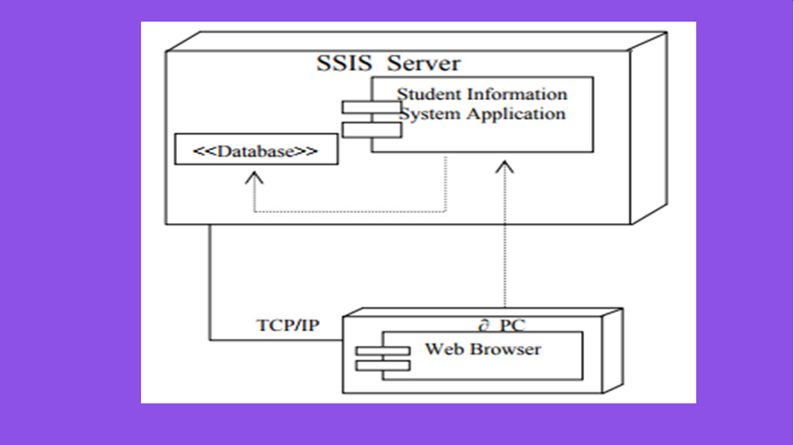
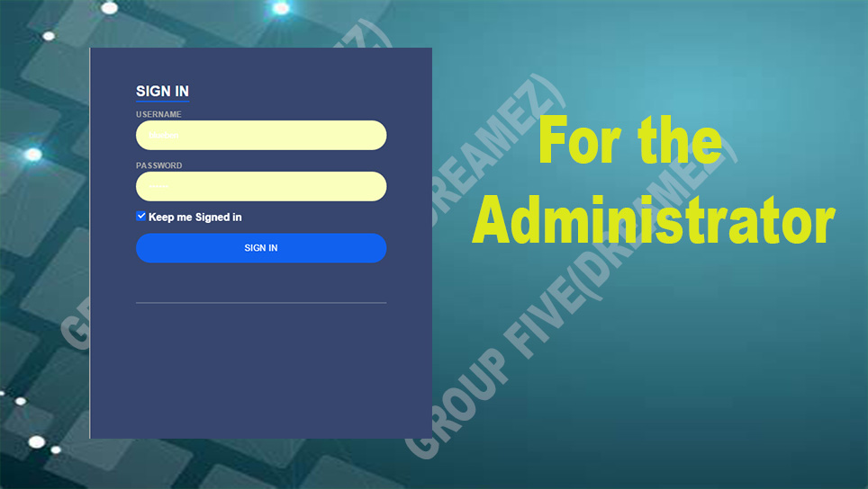
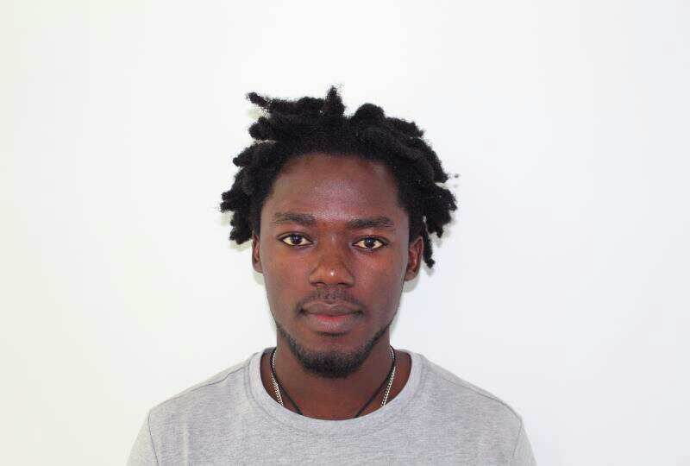
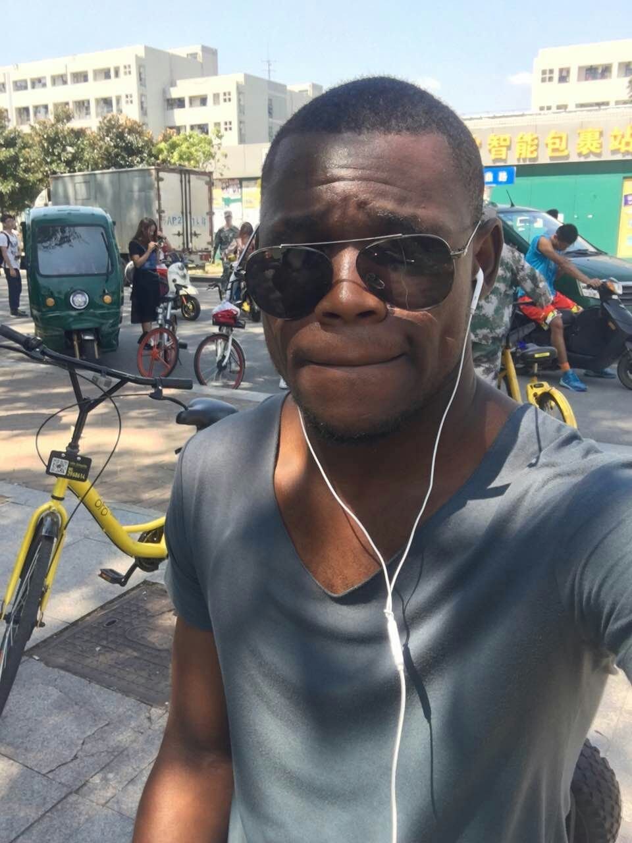
Our Captains
Manuel
Isaac
Meet our Team Captains
Captain
Assistant Captain
Captain Manuel is Ghanian, majoring in CST . He has served the International Soccer Team since 2015 and can't wait to meet you all on the pitch
Assistant Captain Isaac is the absolute best you will see. He is Congolese majoring also in Cst and has served the Team for as long as he has been here. You better show up for practice!!

Slide 4
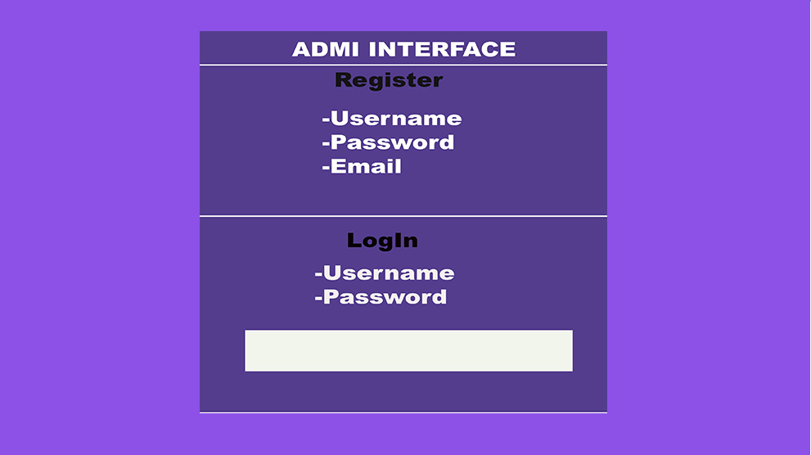
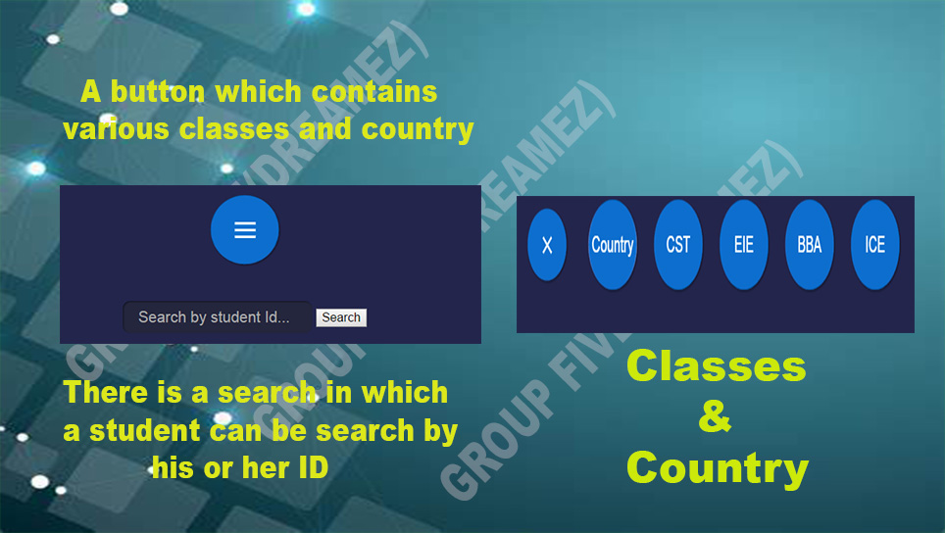

ABOUT
ABOUT US
The International Students Soccer Team was established by a group of students in 2015.
We started with only 8 players.
In 2016 the number of players increased to 16 players this was a major development to our team.
During the 2016 Campaign we had an invitation from Scarlet to participate in the Scarlet 2016 Tournament and we are thrilled to share that most of our players walked away with an award.
We played 6 matches, we trounced one team and had a glorious victory which we are proud of, we drew with one other team and lost 4 matches.
But inlighght of all the games we have lost, we refuse to lose hope we believe that we can do better and we will celebrate more wins this year.
We have two jerseys one which is light blue and green and the other one lime and black.

Slide 5
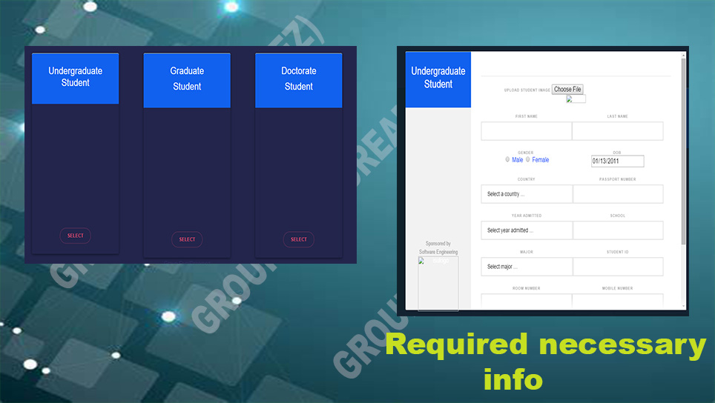
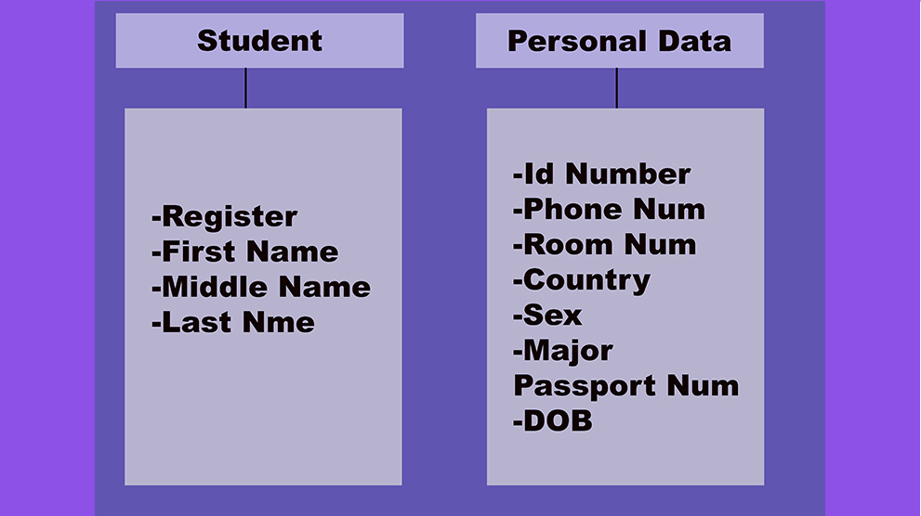
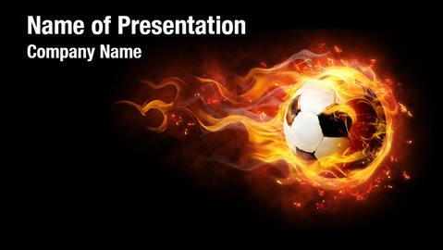
OUR MOTTO
WINNING IS OUR MENTALITY

Slide 6
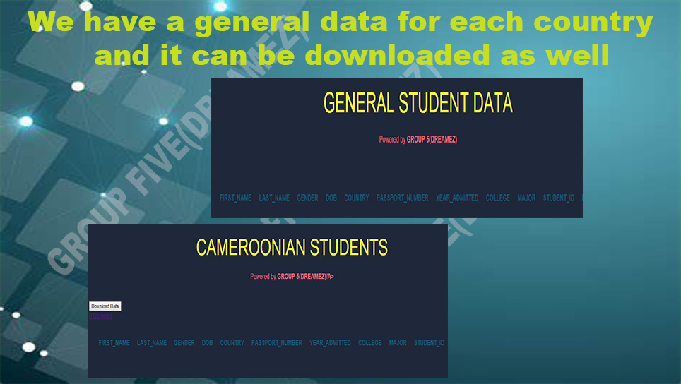
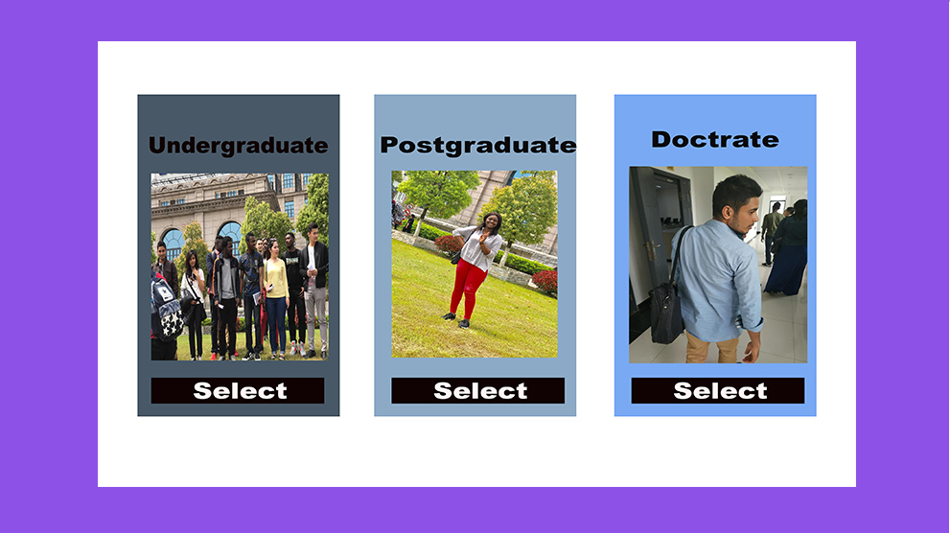

Slide 7

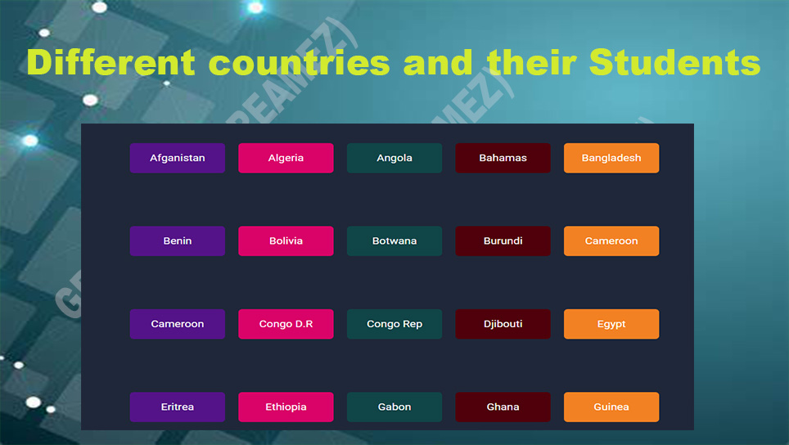

Slide 8
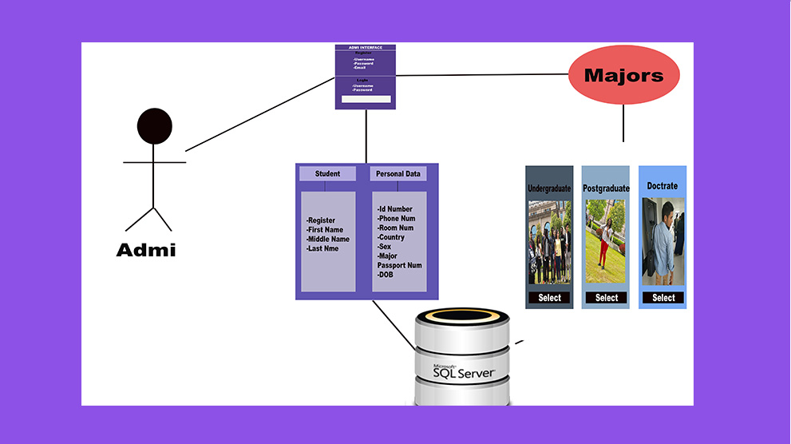
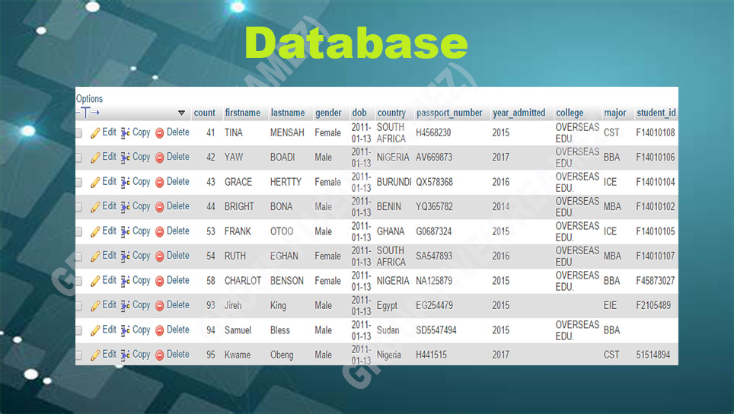

Slide 9
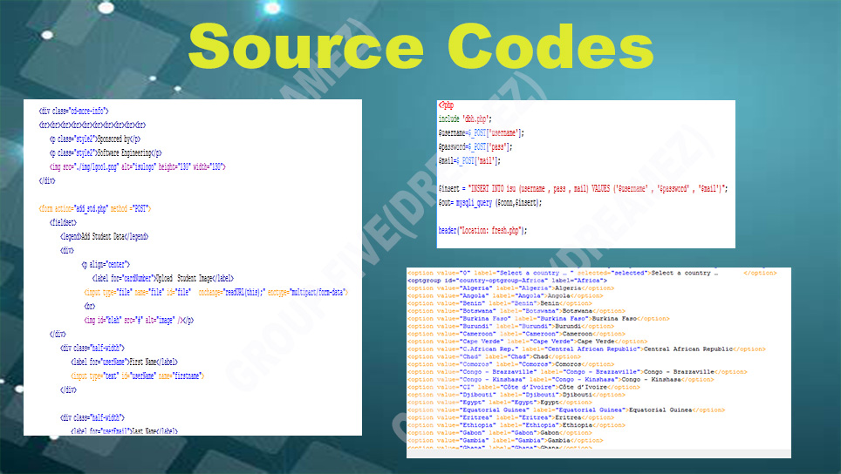

Slide 10
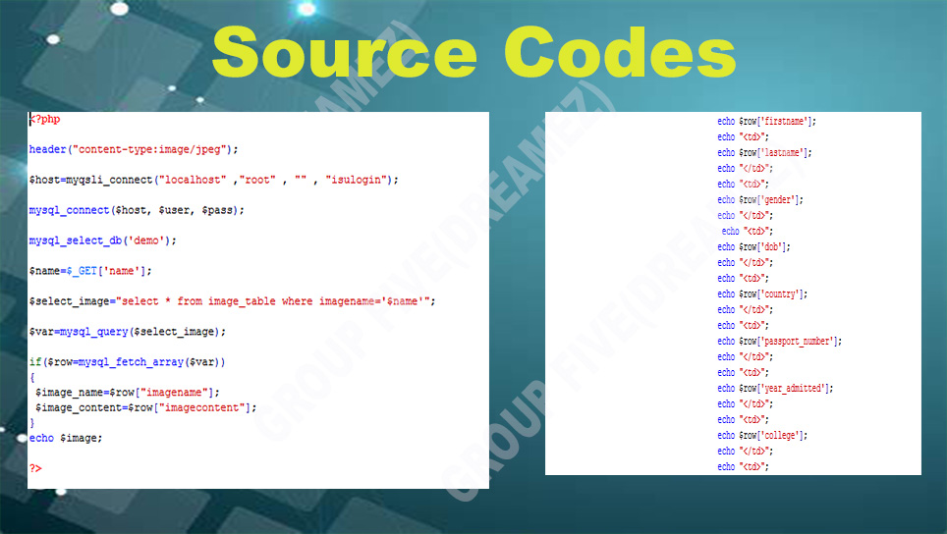

Slide 11
